Slide 1

SummariseMe AI-Powered Summarization for Text, PDF and Video Content
By Team : GENZ CODERS

Slide 2

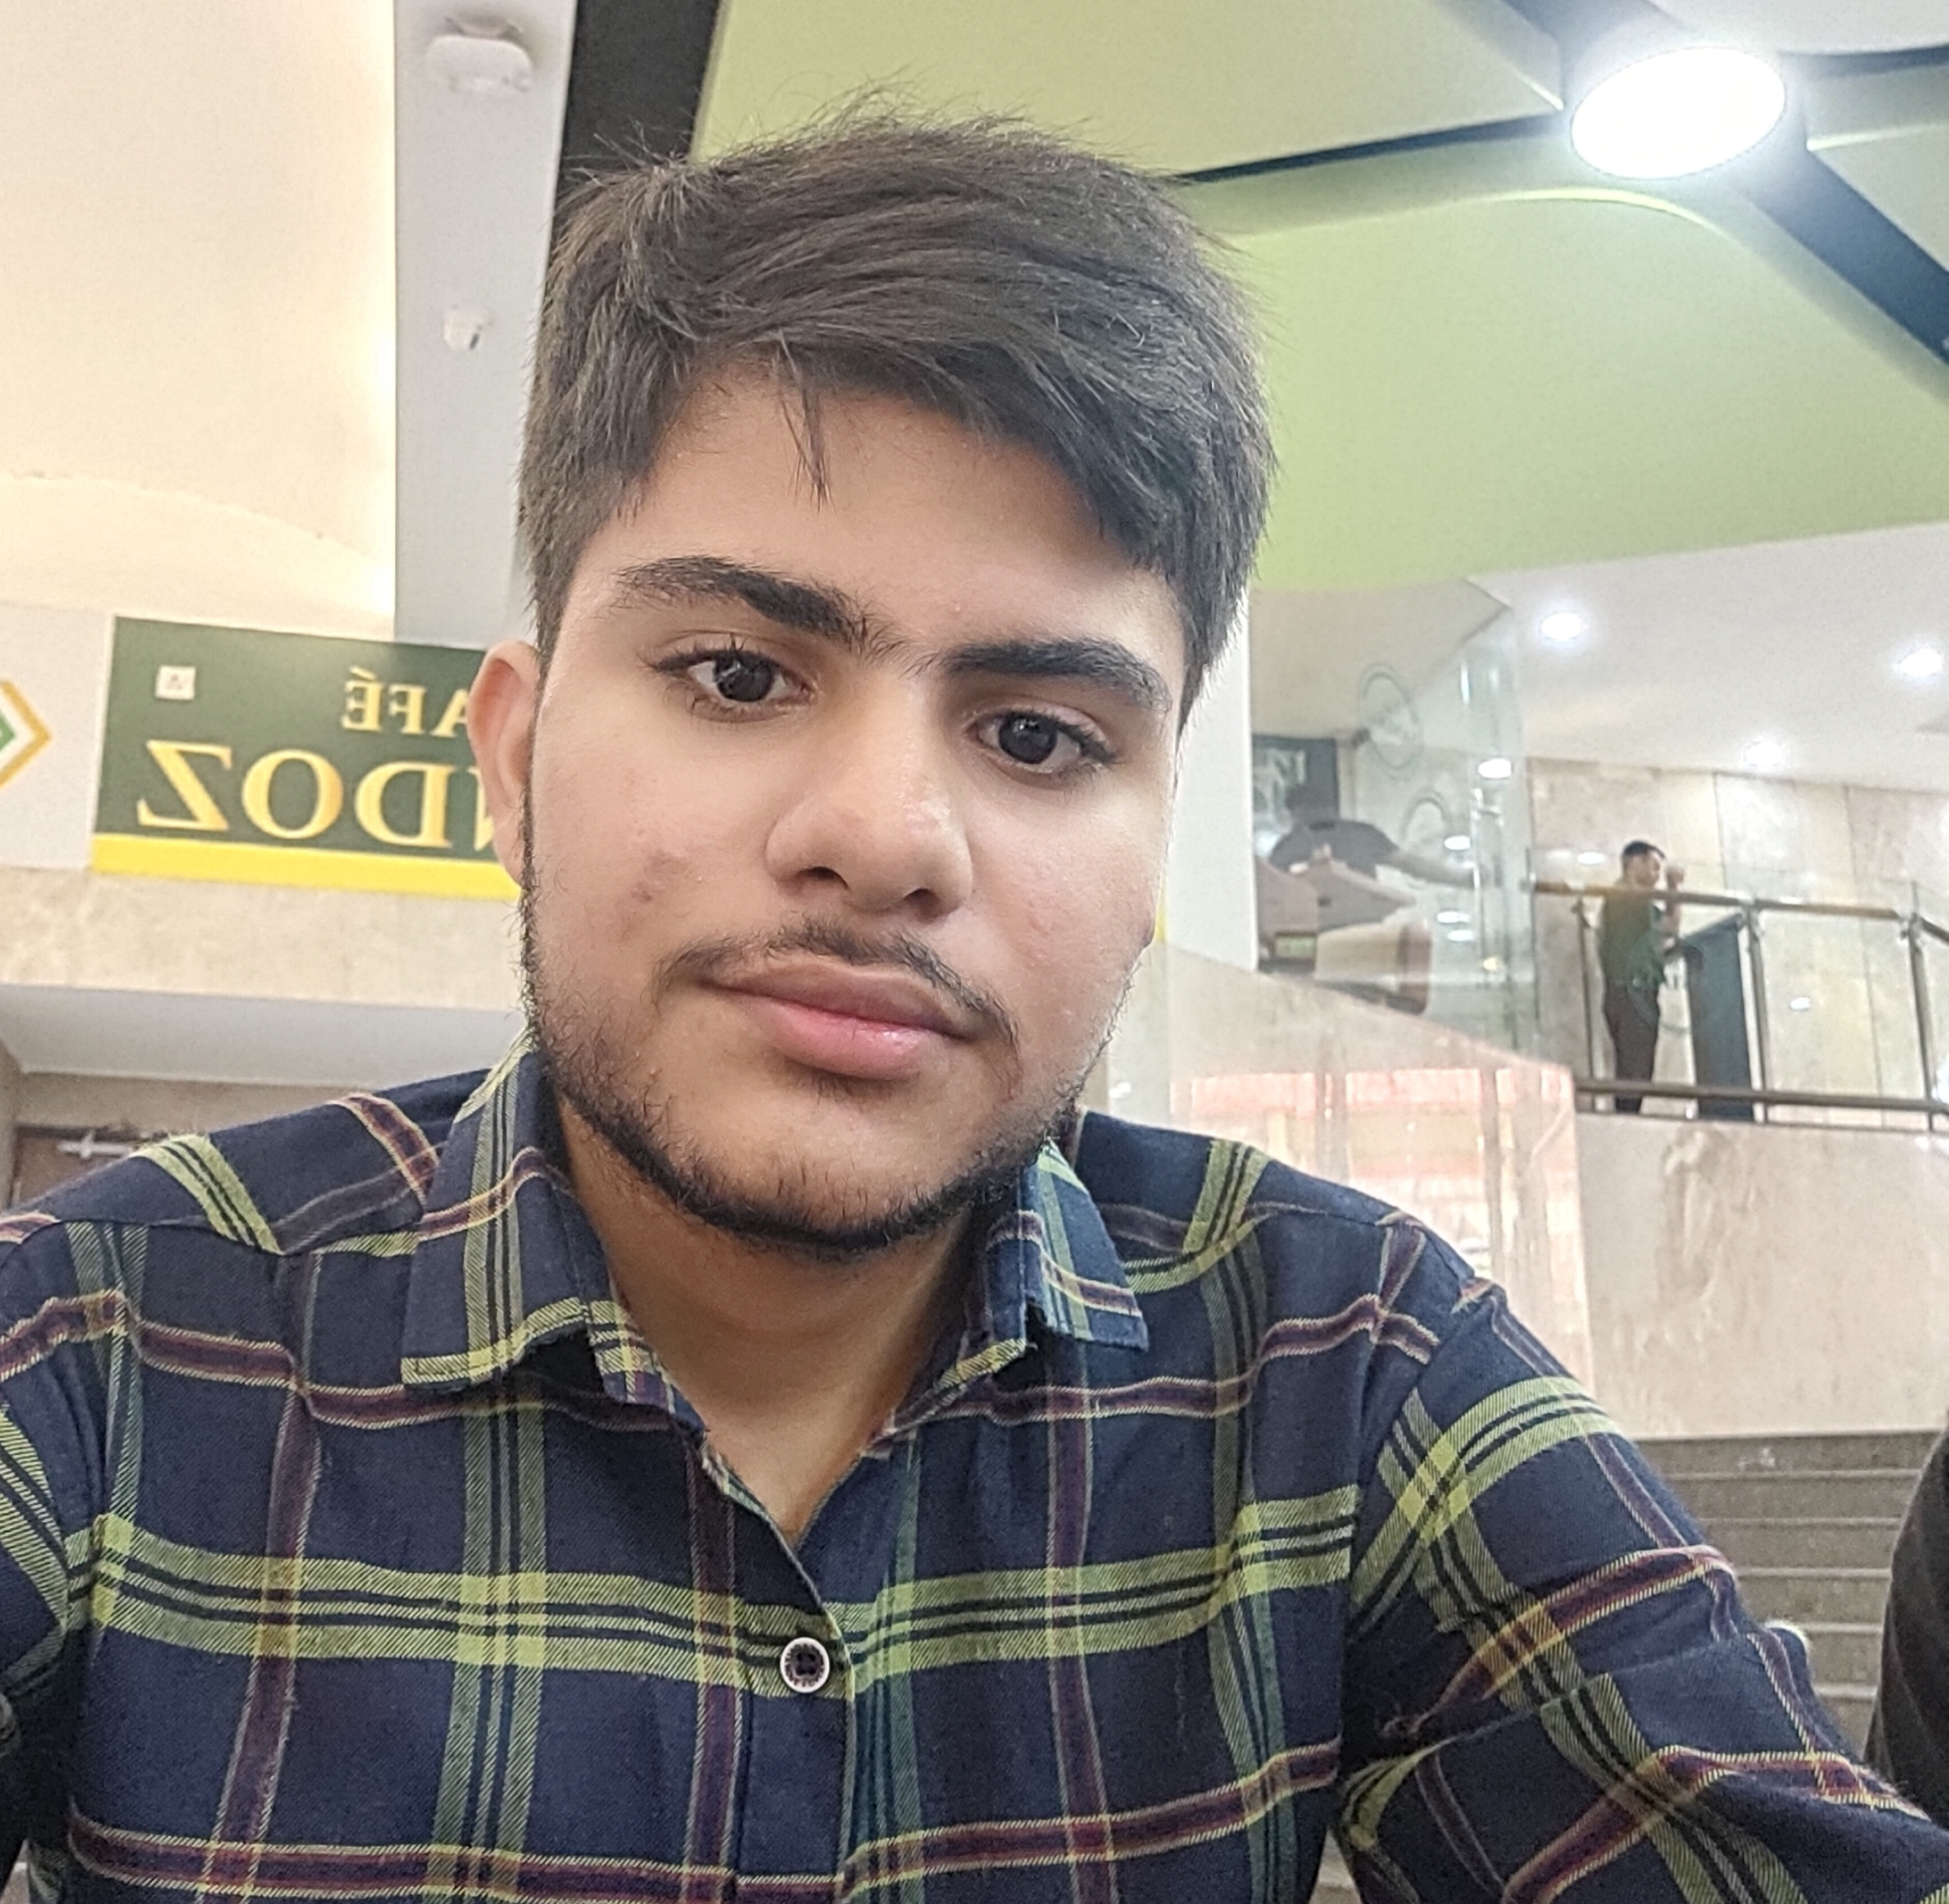


Team: GENZ CODERS
Pratham Upadhyay
Omkar Nath Tripathi
Prince Kumar
EE, 2026 batch
EE, 2026 batch
EE, 2026 batch

Slide 3
Problem Statement
In today's digital age, we're inundated with vast amounts of textual and video content online.
Managing and extracting insights from this content is time-consuming and overwhelming for users.
There's a critical need for tools that can automatically create concise and coherent summaries of long articles and videos, saving users time and effort.

Slide 4
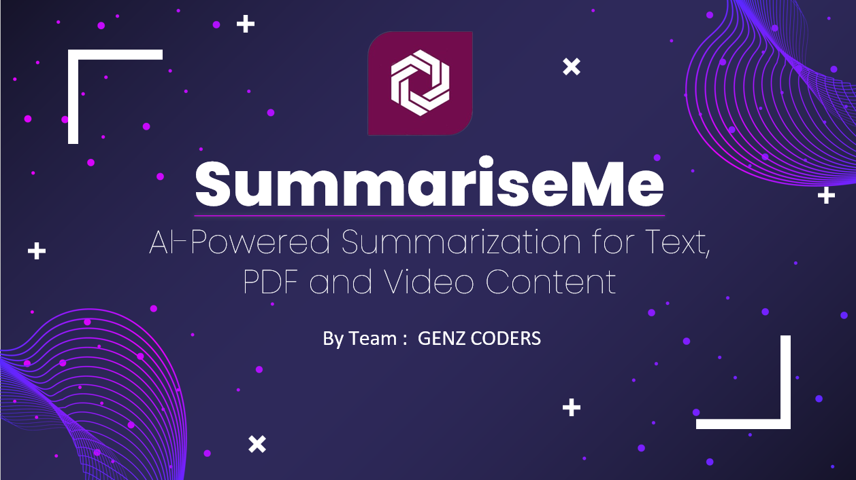
Our Solution
SummariseMe is our answer to this problem.
A Gen AI Powered Summary Generator for Texts, PDFs and Video Content.

Slide 5
How it Address Challenges ?
We have developed an innovative AI system that leverages Generative AI to provide efficient and effective content summarization. Our primary goal is to revolutionize the way users consume textual content and video data.
We aim to provide users with concise and coherent summaries, making it easier for them to access valuable information.

Slide 6
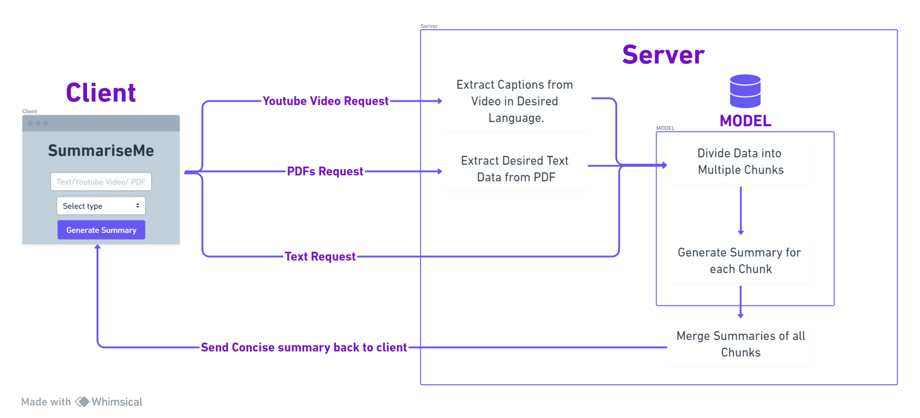
System Design

Slide 7




Our Tech Stack
HTML
CSS
JAVASCRIPT
Used in frontend structure of project.
Making designs in frontend. UI/UX
Connecting to backend and functioning of project
PYTHON
Tensorflow
Model
Used as backend of Project.
Used in model
Model from Hugging face facebook/bart-large-cnn

Slide 8
Let‘s See the Demo!!

Slide 9
Question & Answer

Slide 10
END
ThankYou

